Slide 1
Crash Recovery
courtesy of Joe Hellerstein for some slides
Jianlin Feng
School of Software
SUN YAT-SEN UNIVERSITY
Notes:
1

Slide 2
Review: The ACID properties
Atomicity: All actions in the Xact (transaction) happen, or none happen.
Consistency: If each Xact is consistent, and the DB starts consistent, it ends up consistent.
Isolation: Execution of one Xact is isolated from that of other Xacts.
Durability: If an Xact commits, its effects persist.
The Recovery Manager guarantees Atomicity & Durability.

Slide 3
Motivation
Atomicity:
  Transactions may abort (“Rollback”).
Durability:
  What if DBMS stops running? (Causes?)
Desired state after system restarts:
T1 & T3 should be durable.
T2, T4 & T5 should be aborted (effects should not be seen).
crash!
T1
T2
T3
T4
T5
Commit
Abort
Commit

Slide 4
Assumptions
Concurrency control is in effect.
  Strict 2PL, in particular.
Updates are happening “in place”.
  i.e., data is overwritten on (deleted from) the disk.
Atomic Writes: writing a page to disk is an atomic action.
  In practice, additional details are needed to deal with non-atomic writes.

Slide 5
Buffer Management Policy Plays a Key Role
Shall we allow “dirty pages” in the buffer pool caused by an Xact T to be written to disk before T commits?
  If so, a second Xact T' can “steal” a frame from T.
  In contrast, No-Steal.
When an Xact T commits, must we ensure that all the “dirty pages” of T are immediately forced to disk?
  If so, we say that a “force” approach is used.
  In contrast, No-Force.

Slide 6
Variants of Buffer Management Policy
No Steal
Steal
No Steal
Steal
No Force
Fastest
No UNDO
UNDO
No Force
REDO
REDO
No UNDO
UNDO
Force
Slowest
Force
No REDO
No REDO
Performance
Implications
Logging/Recovery
Implications

Slide 7
Preferred Policy: Steal/No-Force
STEAL (why enforcing Atomicity is hard)
  To steal frame F: Current page in F (say P) is written to disk; some Xact holds lock on P.
    What if the Xact with the lock on P aborts?
    Must remember the old value of P at steal time (to support UNDOing the write to page P).
NO FORCE (why enforcing Durability is hard)
  What if system crashes before an updated page is written to disk?
  Write as little as possible, in a convenient place, at commit time, to support REDOing modifications.

Slide 8



Basic Idea: Logging
Record REDO and UNDO information, for every update, in a log.
  Sequential writes to log (put it on a separate disk).
  Minimal information (difference) written to log, so multiple updates fit in a single log page.
Log: An ordered list of REDO/UNDO actions
  Log record contains:
    <XID, pageID, offset, length, old data, new data>
  and additional control info (which we’ll see soon).
Notes:
7

Slide 9
The Write-Ahead Logging (WAL) Protocol
#1 Must force the log record for an update to disk before the corresponding data page gets to disk.
  This rule helps guarantee Atomicity.
  This allows us to implement Steal policy.
#2 Must write all log records for an Xact to disk before commit.
  I.e. transaction is not committed until all of its log records including its “commit” record are written to disk.
  This rule helps guarantee Durability.
  This allows us to implement No-Force policy.
Exactly how is logging (and recovery!) done?
  We’ll look at the ARIES algorithms from IBM.

Slide 10


WAL & the Log
DB
RAM
LSNs
pageLSNs
flushedLSN
Each log record has a unique Log Sequence Number (LSN).
  LSNs is always increasing.
Each data page contains a pageLSN.
  The LSN of the most recent log record for an update to that page.
System keeps track of flushedLSN.
  The max LSN flushed so far.
WAL: Before page i is written to disk, log must satisfy:
  pageLSN_{i} ≤ flushedLSN,
  i.e., the log record identified by pageLSN_{i} must have been written to disk for page i is written to disk.
Log records
flushed to disk
flushedLSN
pageLSN
“Log tail”
in RAM

Slide 11
Log Records
prevLSN is the LSN of the previous log record written by this Xact (so records of an Xact form a linked list backwards in time)
Possible log record types:
Update, Commit, Abort
Checkpoint (for log maintainence)
Compensation Log Records (CLRs)
  for UNDO actions
End (end of commit or abort)
LogRecord fields:
LSN
prevLSN
XID
type
pageID
update
records
only
length
offset
before-image
after-image

Slide 12
Other Log-Related Data Structures
Two in-memory tables:
Transaction Table
  One entry per currently active Xact.
    entry removed when Xact commits or aborts
  Contains XID, status (running/committing/aborting), and lastLSN (most recent LSN written by Xact).
Dirty Page Table:
  One entry per dirty page currently in buffer pool.
  Contains recLSN -- the LSN of the log record which first caused the page to be dirty.

Slide 13
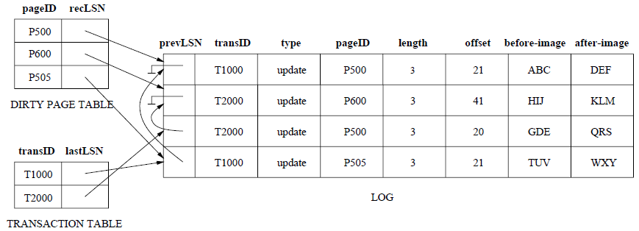
An Example

Slide 14
The Big Picture: What’s Stored Where
LOG
DB
RAM
LogRecords
LSN
prevLSN
Xact Table
lastLSN
status
Dirty Page Table
recLSN
flushedLSN
Data pages
each
with a
pageLSN
XID
type
pageID
length
Master record
LSN
of most recent
checkpoint record
offset
before-image
after-image

Slide 15
Normal Execution of an Xact
Series of reads & writes, followed by commit or abort.
Strict 2PL.
STEAL, NO-FORCE buffer management, with Write-Ahead Logging.

Slide 16
Transaction Commit
Write commit record to log.
All log records up to Xact’s commit record are flushed to disk.
  Guarantees that flushedLSN ≥ lastLSN.
  Note that log flushes are sequential, synchronous writes to disk.
  Many log records per log page.
Commit() returns.
Write end record to log.

Slide 17
Simple Transaction Abort
For now, consider an explicit abort of an Xact.
  No crash involved.
We want to “play back” the log in reverse order, UNDOing updates.
  Get lastLSN of Xact from Xact table.
  Write an Abort log record before starting to rollback operations
  Can follow chain of log records backward via the prevLSN field.
  Write a “CLR” (compensation log record) for each undone operation.

Slide 18

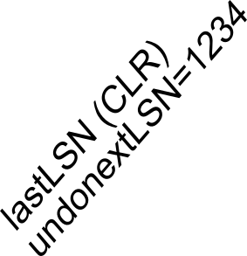
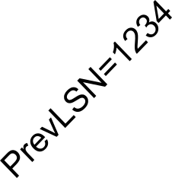


Abort, cont.
To perform UNDO, must have a lock on data!
  No problem!
Before restoring old value of a page, write a CLR:
  You continue logging while you UNDO!!
  CLR has one extra field: undonextLSN
    Points to the next LSN to undo (i.e. the prevLSN of the record we’re currently undoing).
  CLR contains REDO info
  CLRs never Undone
    Undo needn’t be idempotent (>1 UNDO won’t happen)
    But they might be Redone when repeating history (=1 UNDO guaranteed)
At end of all UNDOs, write an “end” log record.

Slide 19
Checkpointing
Usually, we can not keep log around for all time.
Periodically, the DBMS creates a checkpoint
  Minimizes recovery time after crash. Write to log:
    begin_checkpoint record: Indicates when the checkpoint began.
    end_checkpoint record: Contains current Xact table and dirty page table. A`fuzzy checkpoint’:
      Other Xacts continue to run; so these tables accurate only as of the time of the begin_checkpoint record.
      No attempt to force dirty pages to disk; effectiveness of checkpoint limited by oldest unwritten change to a dirty page.
    Store LSN of most recent checkpoint record in a safe place (master record).

Slide 20
Crash Recovery: Big Picture
Oldest log rec. of Xact active at crash
Start from a checkpoint (found via master record).
Three phases. Need to do:
  Analysis - Figure out which Xacts committed since checkpoint, which failed.
  REDO all actions.
    (repeat history)
  UNDO effects of failed Xacts.
Smallest recLSN in dirty page table after Analysis
Last chkpt
CRASH
A
R
U

Slide 21
Recovery: The Analysis Phase
Re-establish knowledge of state at checkpoint.
  via transaction table and dirty page table stored in the checkpoint
Scan log forward from the most recent checkpoint.
  End record: Remove Xact from Xact table.
  All Other records: Add Xact to Xact table, set lastLSN=LSN, change Xact status on commit record.
  also, for Update records: If page P not in Dirty Page Table (DPT), Add P to DPT, set its recLSN=LSN.
At the end of Analysis…
  Xact table says which xacts were active at time of crash.
  DPT says which dirty pages might not have been written to disk.

Slide 22
Phase 2: The REDO Phase
We Repeat History to reconstruct state at crash:
  Reapply all updates (even of aborted Xacts!), redo CLRs.
Scan forward from log record containing smallest recLSN in DPT.
For each update log record or CLR with a given LSN, REDO the action unless:
  Affected page is not in the DPT, or
  Affected page is in DPT, but has recLSN > LSN, or
  pageLSN (in DB) ≥ LSN. (this last case requires I/O)
To REDO an action:
  Reapply logged action.
  Set pageLSN to LSN. No additional logging, no forcing!

Slide 23
Phase 3: The UNDO Phase
A Naïve solution:
  The xacts in the Xact Table are losers.
  For each loser, perform simple transaction abort.
  Problems?

Slide 24
Phase 3: The UNDO Phase
ToUndo={lastLSNs of all Xacts in the Xact Table}
a.k.a. “losers”
Repeat:
  Choose (and remove) largest LSN among ToUndo.
  If this LSN is a CLR and undonextLSN==NULL
    Write an End record for this Xact.
  If this LSN is a CLR, and undonextLSN != NULL
    Add undonextLSN to ToUndo
  Else this LSN is an update. Undo the update, write a CLR, add prevLSN to ToUndo.
Until ToUndo is empty.
NOTE: This is simply a performance optimization on the naïve solution to do it in one backwards pass of the log!

Slide 25
Example of Recovery
LSN LOG
RAM
00
05
10
20
30
40
45
50
60
begin_checkpoint
end_checkpoint
update: T1 writes P5
update T2 writes P3
T1 abort
CLR: Undo T1 LSN 10
T1 End
update: T3 writes P1
update: T2 writes P5
CRASH, RESTART
Xact Table
lastLSN
status
Dirty Page Table
recLSN
flushedLSN
prevLSNs
ToUndo

Slide 26
Example: Crash During Restart!
LSN LOG
00,05
10
20
30
40,45
50
60
70
80,85
90
begin_checkpoint, end_checkpoint
update: T1 writes P5
update T2 writes P3
T1 abort
CLR: Undo T1 LSN 10, T1 End
update: T3 writes P1
update: T2 writes P5
CRASH, RESTART
CLR: Undo T2 LSN 60
CLR: Undo T3 LSN 50, T3 end
CRASH, RESTART
CLR: Undo T2 LSN 20, T2 end
RAM
undonextLSN
Xact Table
lastLSN
status
Dirty Page Table
recLSN
flushedLSN
ToUndo

Slide 27
Additional Crash Issues
What happens if system crashes during Analysis? During REDO?
How do you limit the amount of work in REDO?
  Flush asynchronously in the background.
  Watch “hot spots”!
How do you limit the amount of work in UNDO?
  Avoid long-running Xacts.

Slide 28
Summary of Logging/Recovery
Recovery Manager guarantees Atomicity & Durability.
Use WAL to allow STEAL/NO-FORCE w/o sacrificing correctness.
LSNs identify log records; linked into backwards chains per transaction (via prevLSN).
pageLSN allows comparison of data page and log records.

Slide 29
Summary (Contd.)
Checkpointing: A quick way to limit the amount of log to scan on recovery.
Recovery works in 3 phases:
  Analysis: Forward from checkpoint.
  Redo: Forward from oldest recLSN.
  Undo: Backward from end to first LSN of oldest Xact alive at crash.
Upon Undo, write CLRs.
Redo “repeats history”: Simplifies the logic!

